Slide 1

Digital Image Processing CS390S
Feng Jiang
2018 Spring

Slide 2
Welcome!
CS390S
Introduction (instructor, students, course)
What is digital image processing
Basics of an image

Slide 3
Introduction - instructor
Dr. Feng Jiang
PhD, Multimedia Security, Purdue University
Email: fjiang@msudenver.edu
Office: AES 200U
Telephone: 303-615-1258

Slide 4
Introduction - instructor
My research work

Slide 5
Introduction - students
Introduce yourself to your neighbor
Let your neighbor introduce you to the class

Slide 6
Introduction - course
Course Syllabus available on blackboard
Course Policies
Waitlist procedure

Slide 7
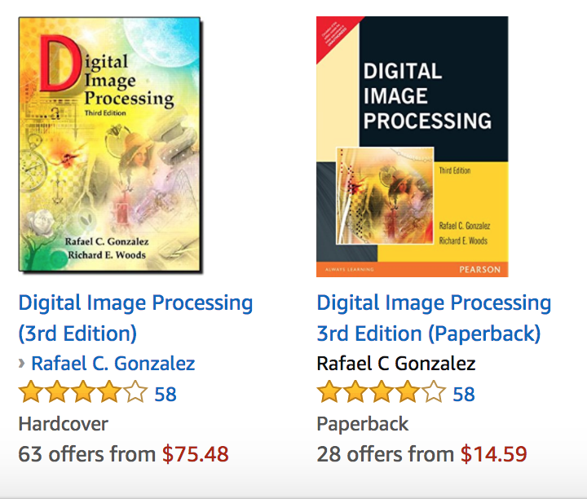
Resources
Books:
Digital Image Processing 3rd Ed
Digital Image Processing Using Matlab 2nd Ed
Links:
http://www.imageprocessingplace.com/index.htm
https://web.stanford.edu/class/ee368/handouts.html
Dataset
http://www.imageprocessingplace.com/root_files_V3/image_databases.htm
http://www.image-net.org/
Labs
http://vision.stanford.edu/

Slide 8
Software
Matlab
https://www.mathworks.com/pricing-licensing.html?intendeduse=student&prodcode=ML
Please bring your laptop to class
https://www.mathworks.com/campaigns/academia/ppc/google/buy-matlab-student.html?s_eid=ppc_6207971722&q=matlab%20student%20price

Slide 9
What is an image?

Slide 10
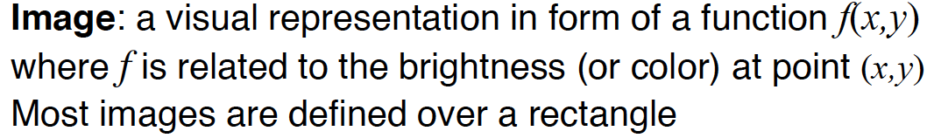
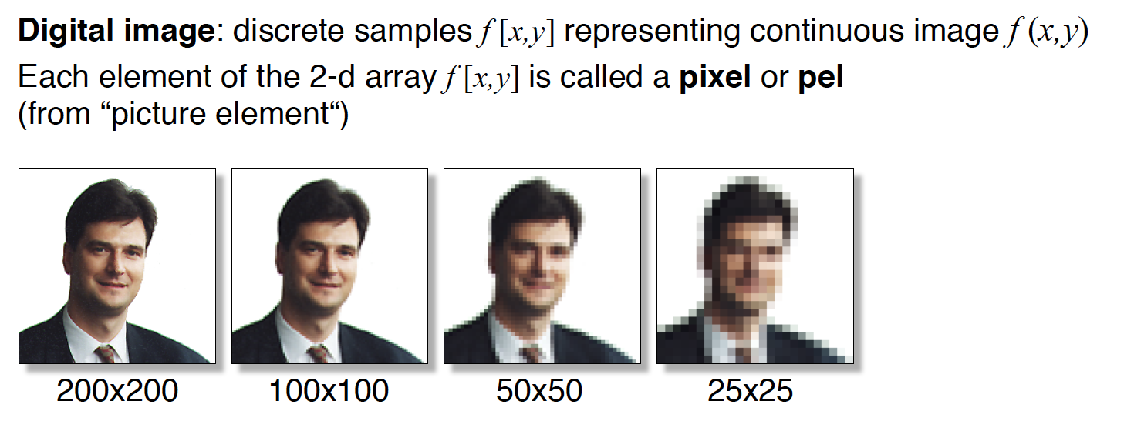
Digital Image

Slide 11
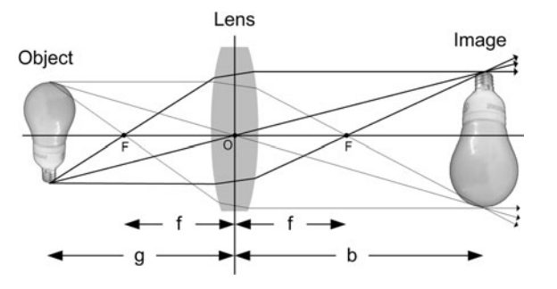
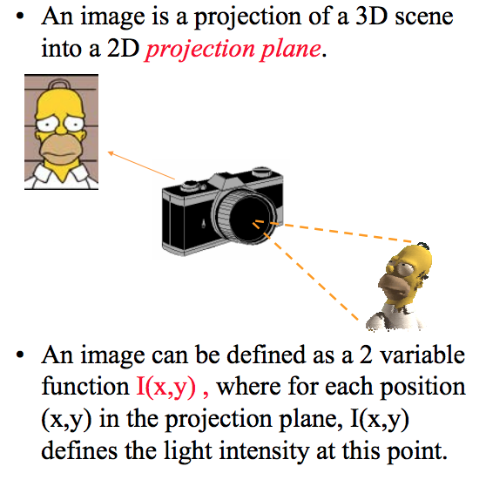
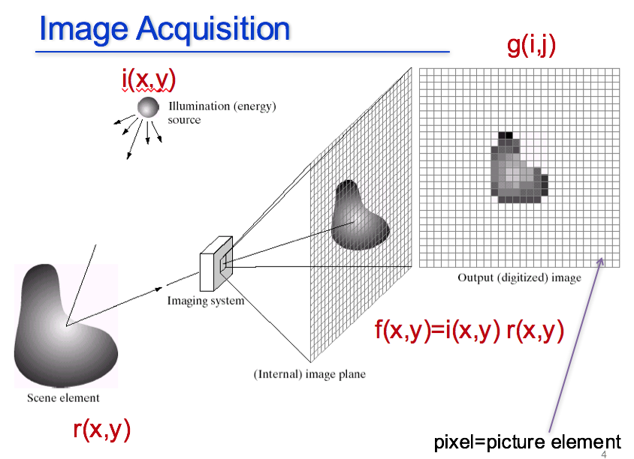
Imaging System
Image acquisition
Real scenery/object
Sensor

Slide 12
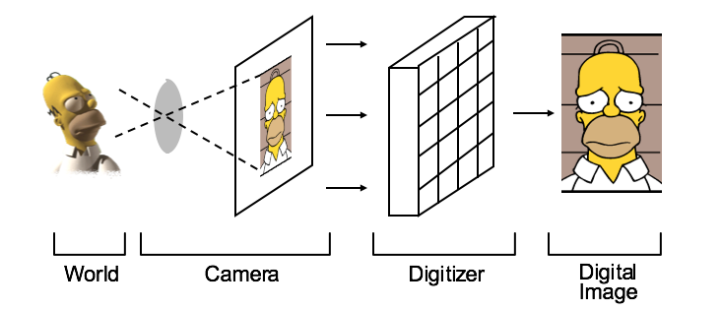
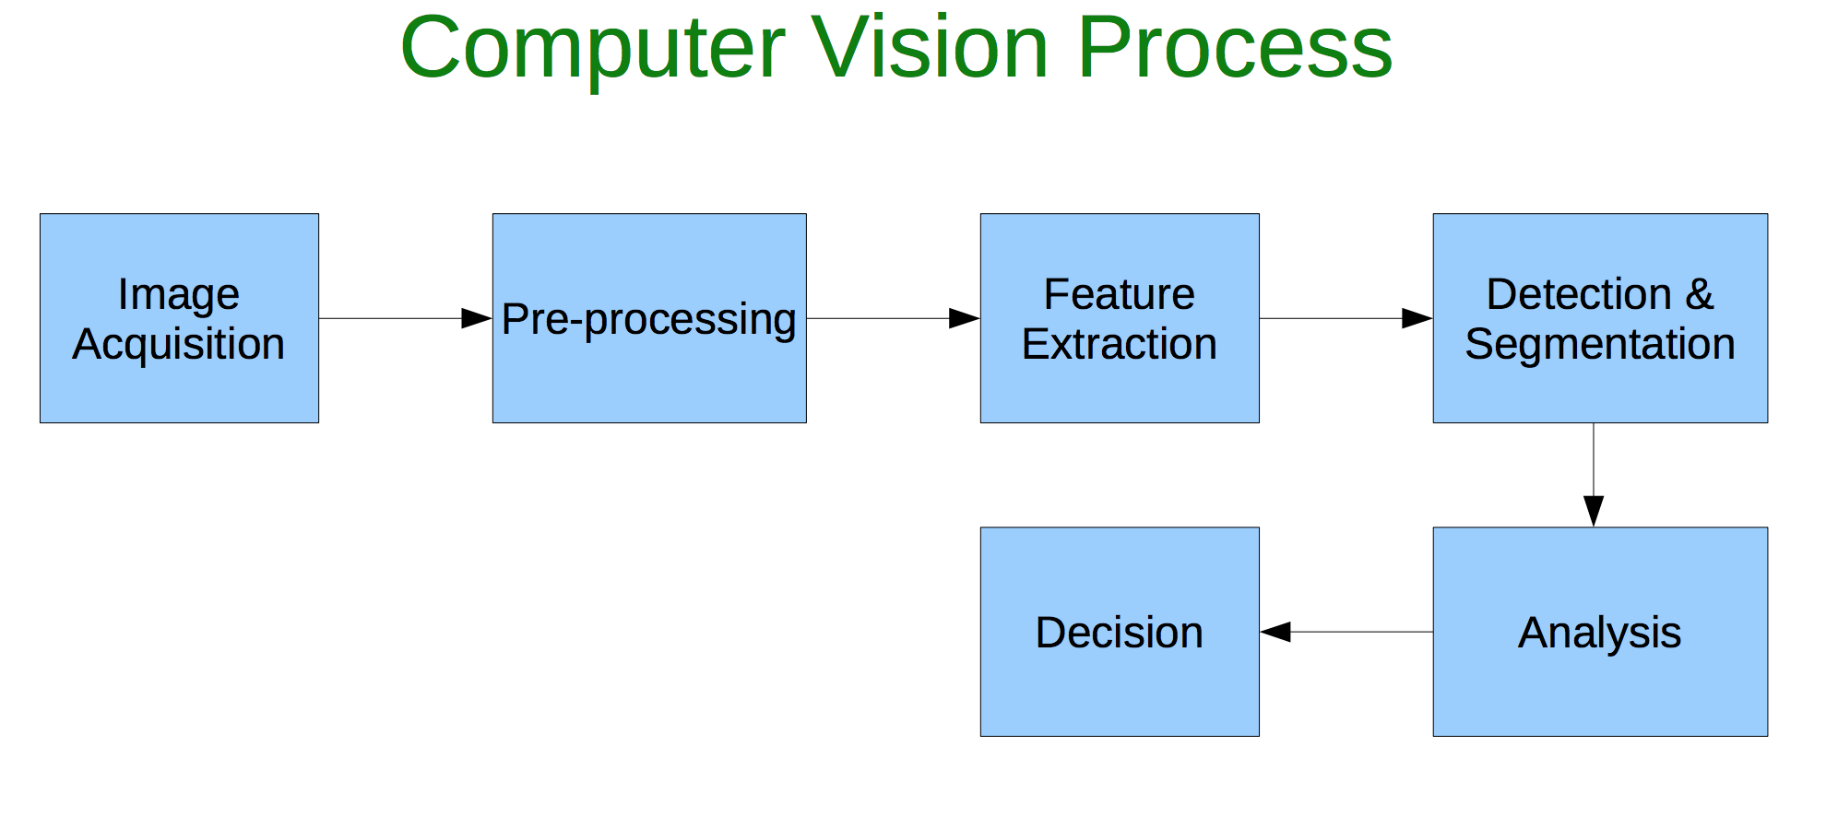
Imaging System
Image acquisition

Slide 13
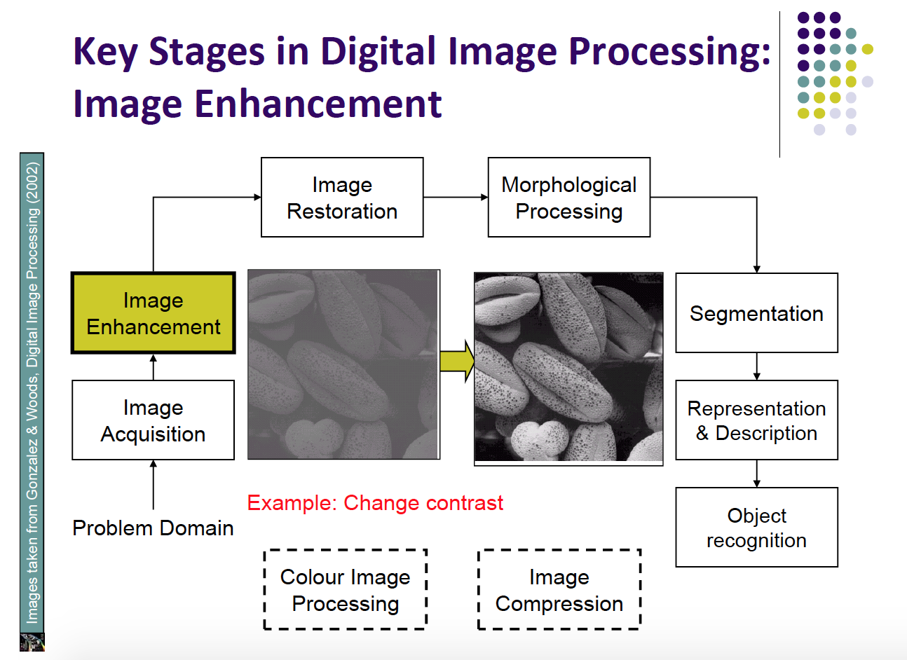
Digital Image Processing

Slide 14
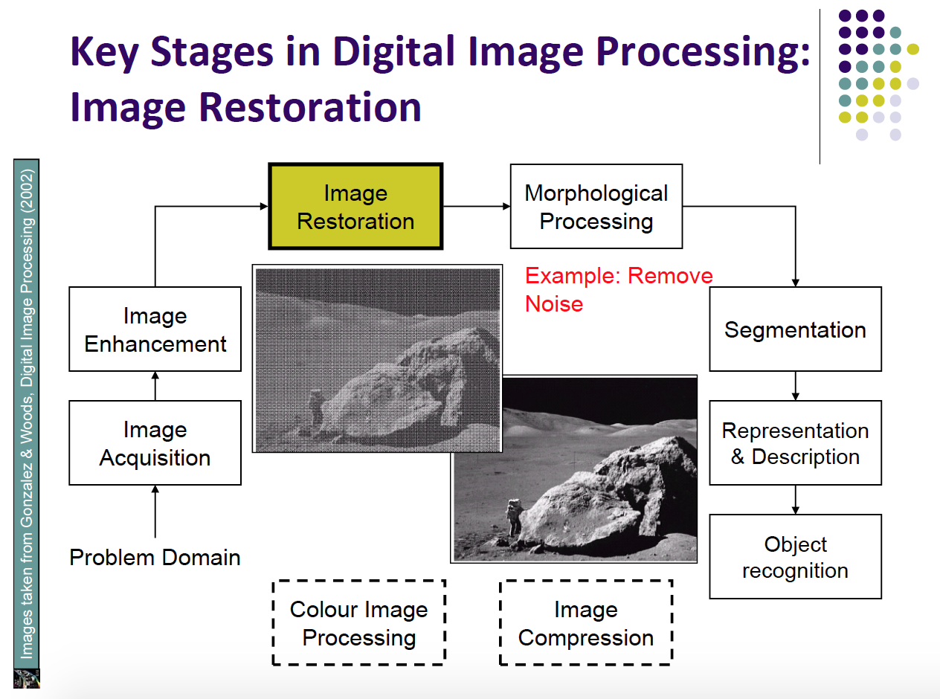
Digital Image Processing

Slide 15
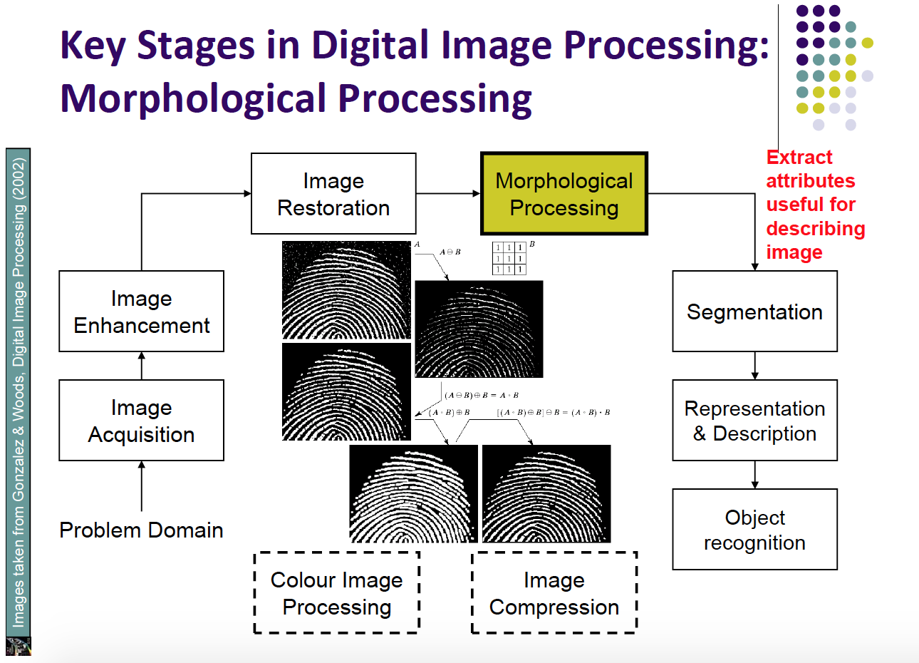
Digital Image Processing

Slide 16
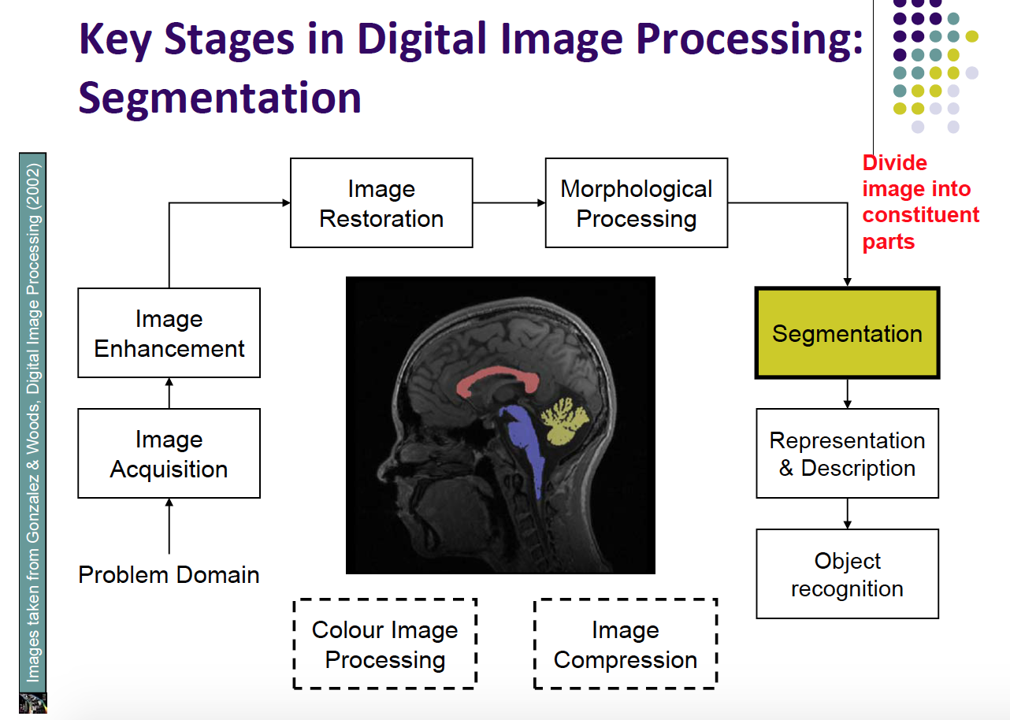
Digital Image Processing

Slide 17
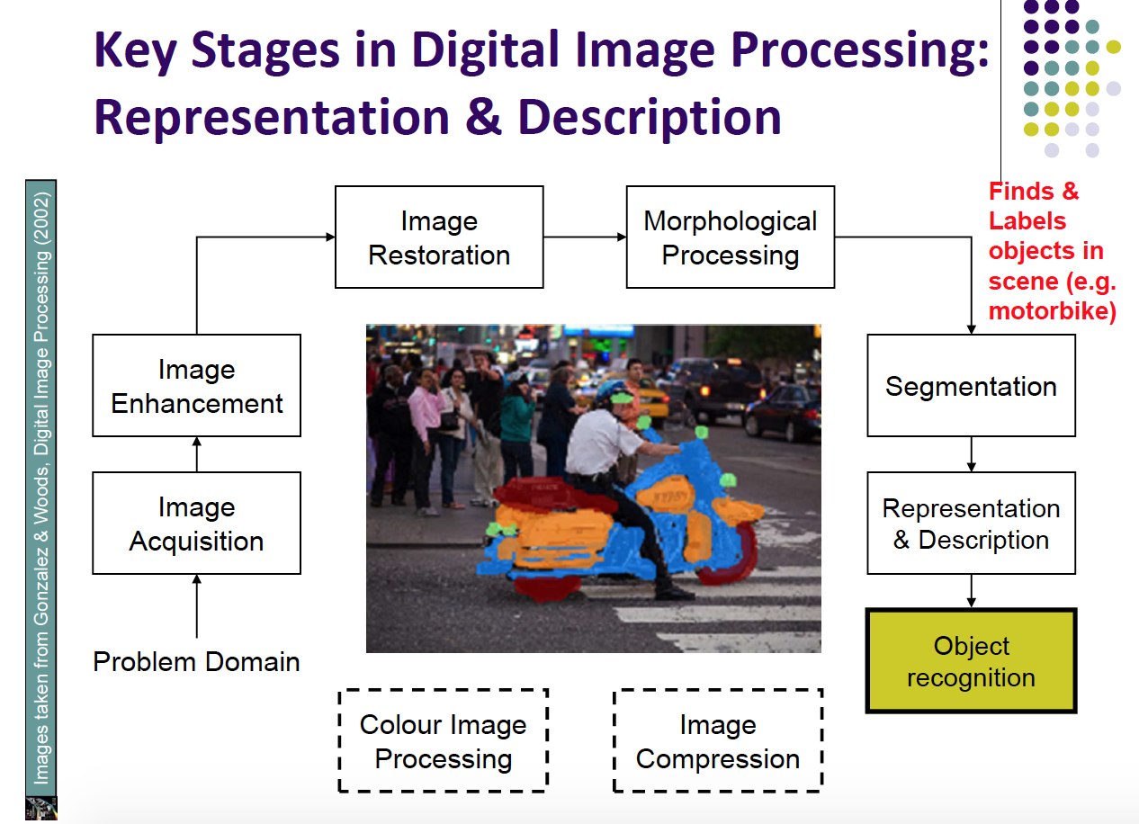
Digital Image Processing

Slide 18
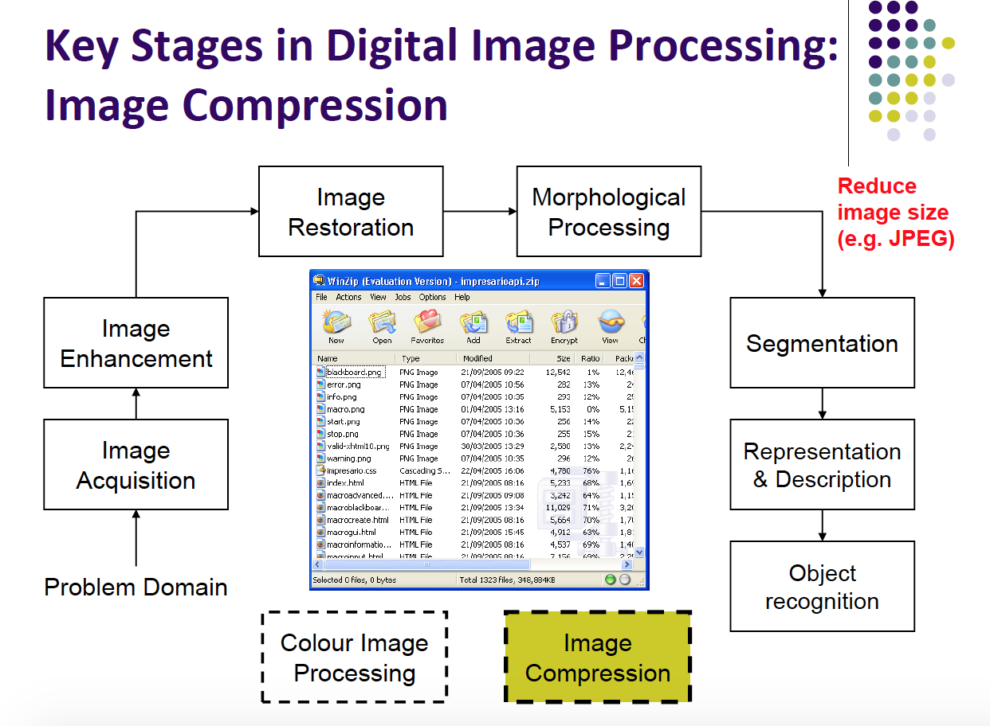
Digital Image Processing

Slide 19
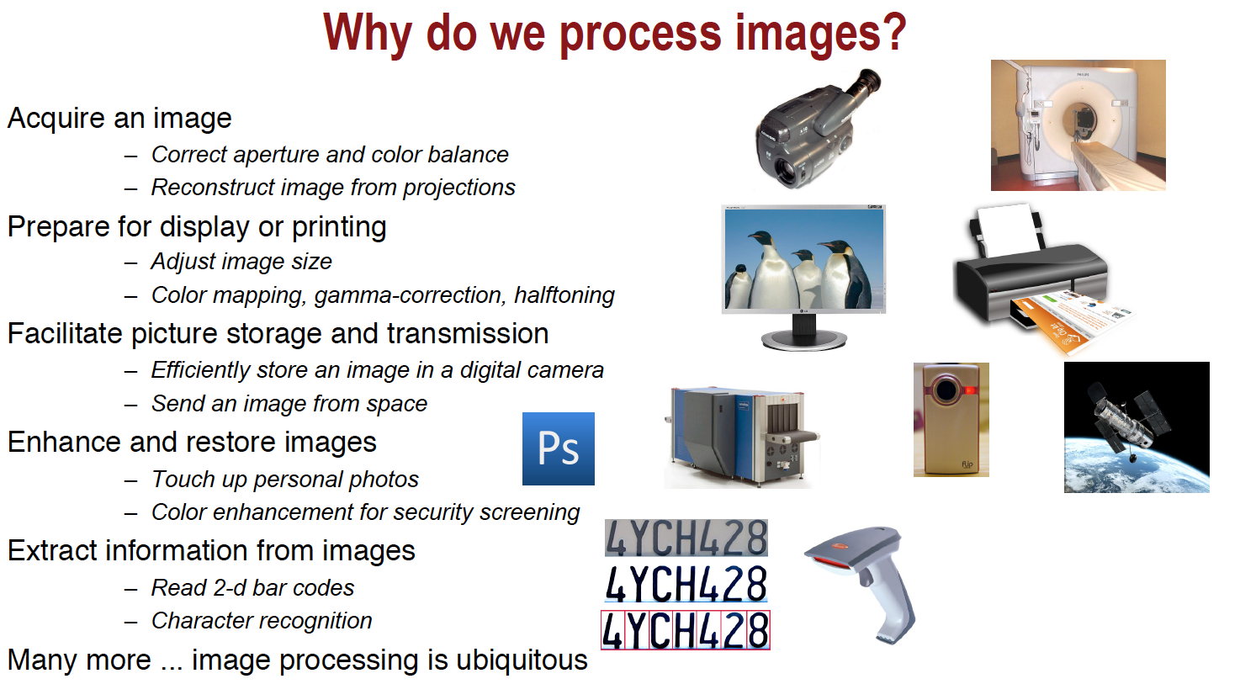
Applications of DIP(digital image processing)

Slide 20
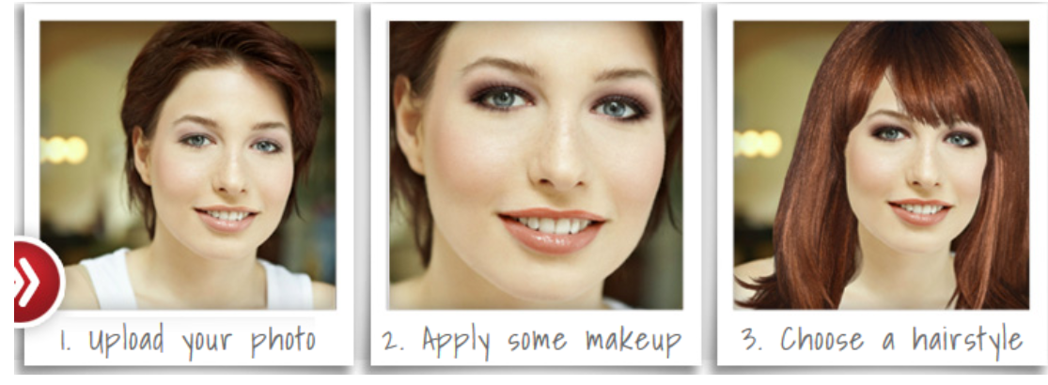
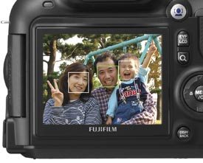
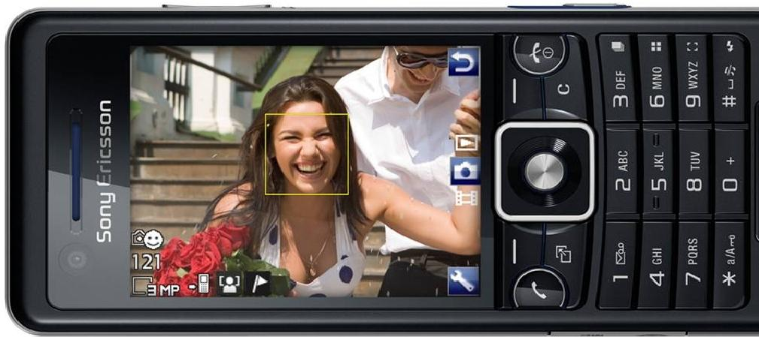
Face Detection & Virtual Makeover
Applications of DIP

Slide 21

Applications of DIP
Transportation Safety
Pedestrian Detection and
Behavior Analysis

Slide 22
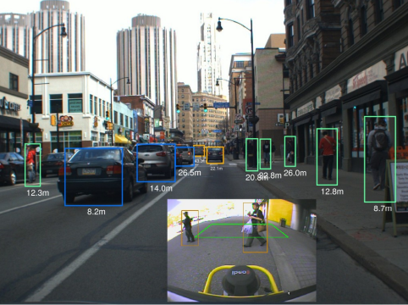
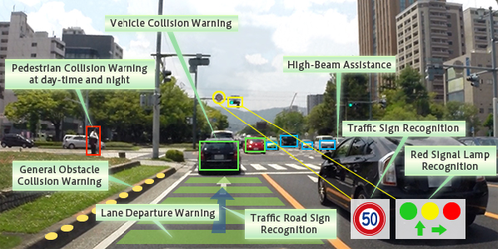
Advanced Driver Assistance System (ADAS)
Applications of DIP

Slide 23
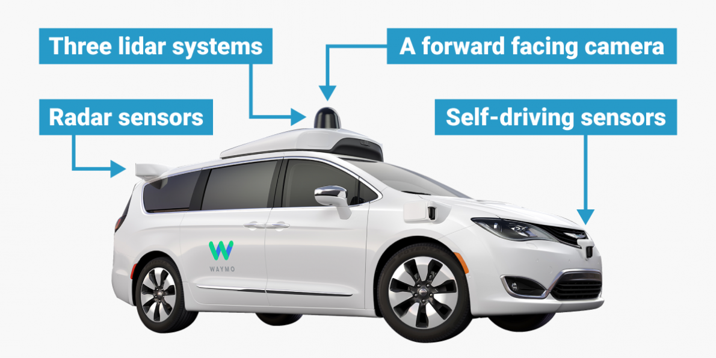
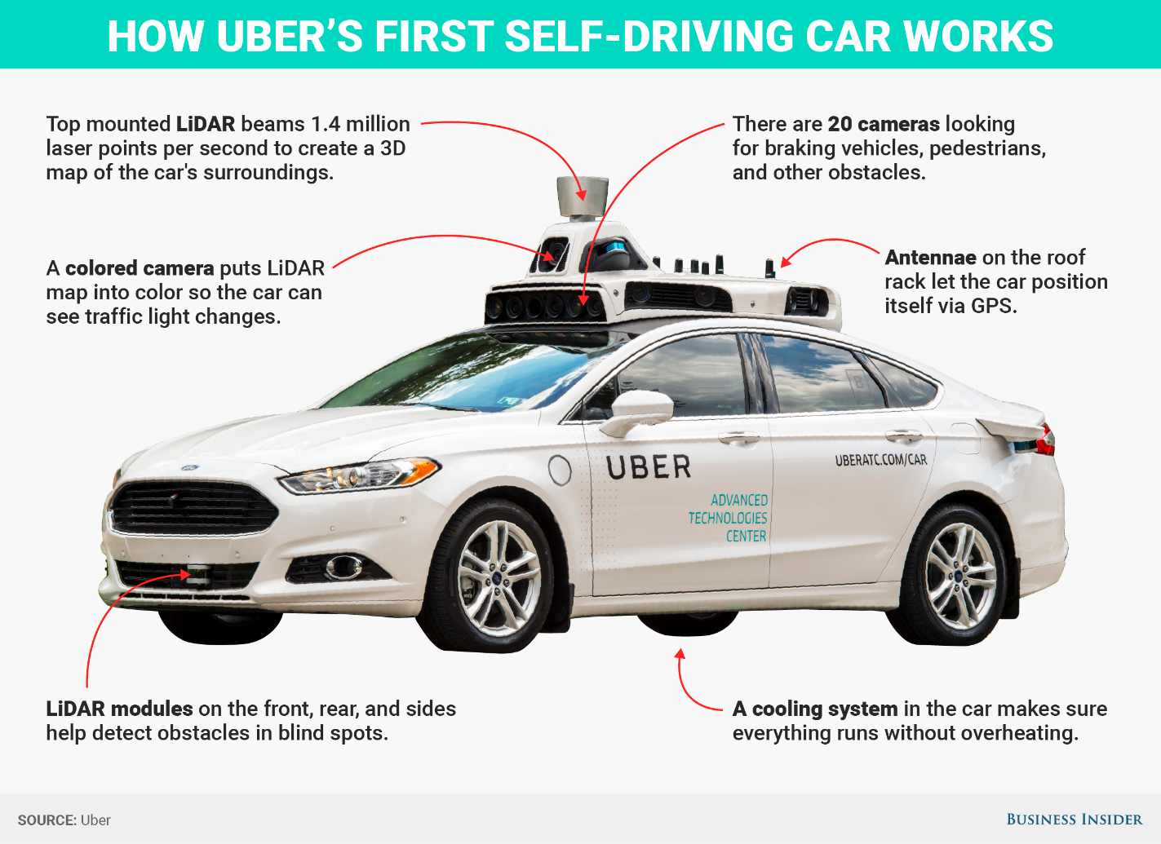
Self-Driving Car
Applications of DIP

Slide 24
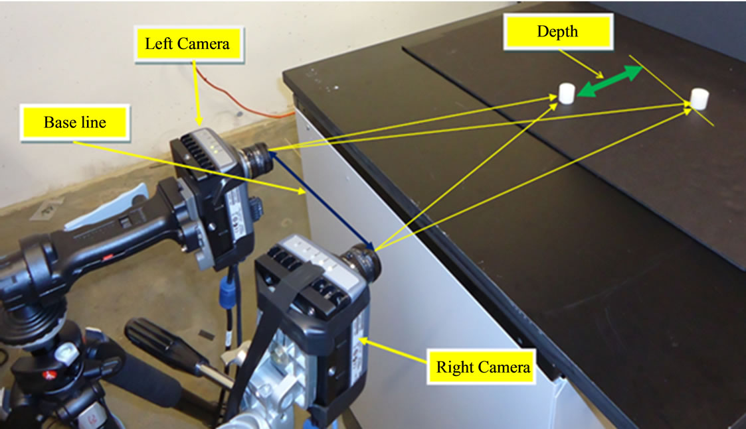
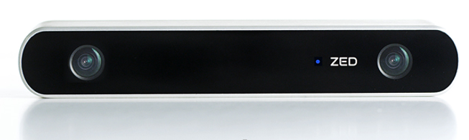
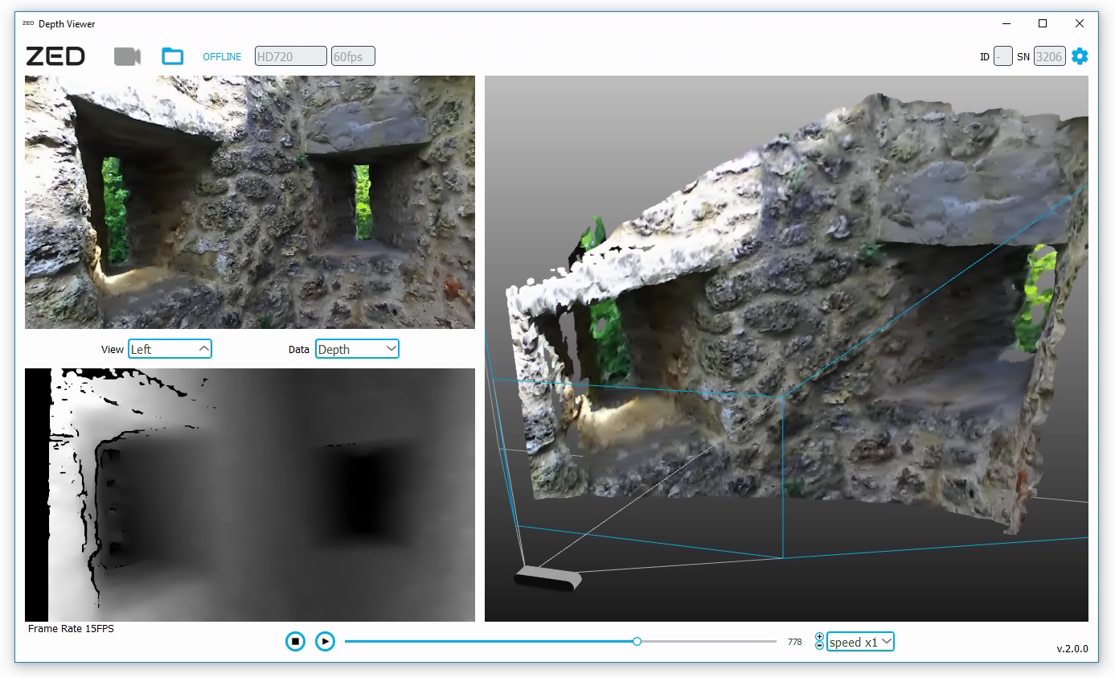
Stereo Imaging
Applications of DIP

Slide 25
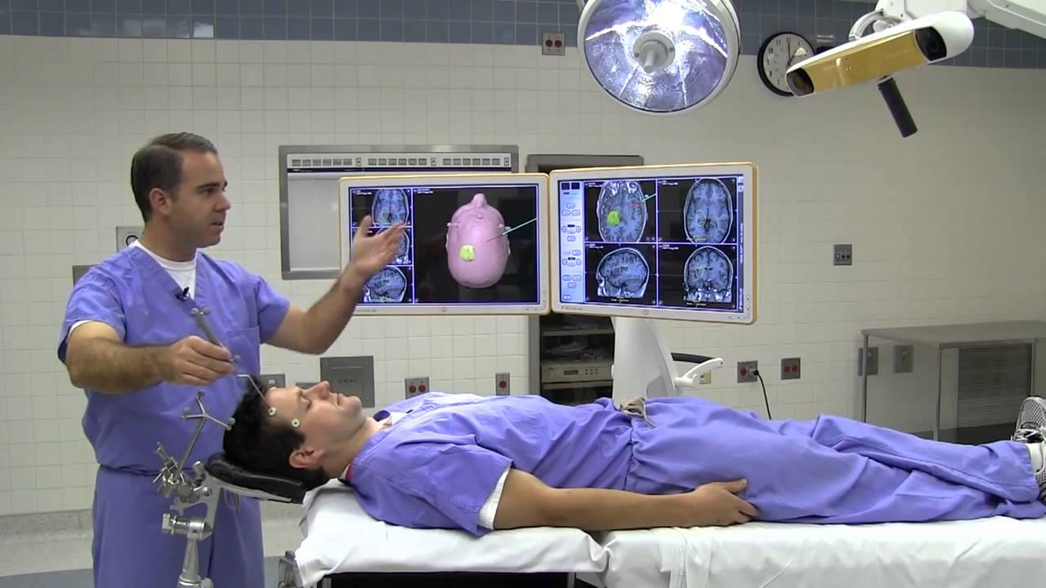
Image Guided Surgery
Applications of DIP
https://www.youtube.com/watch?v=N6Xn--e90oQ

Slide 26
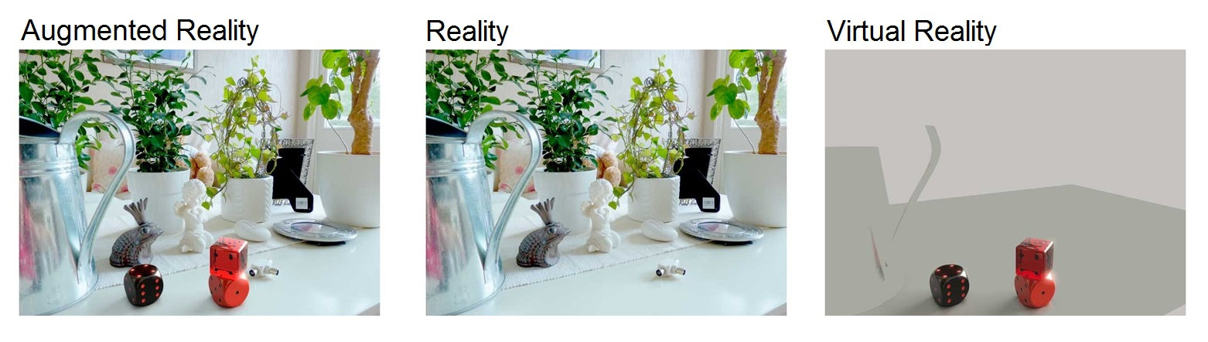
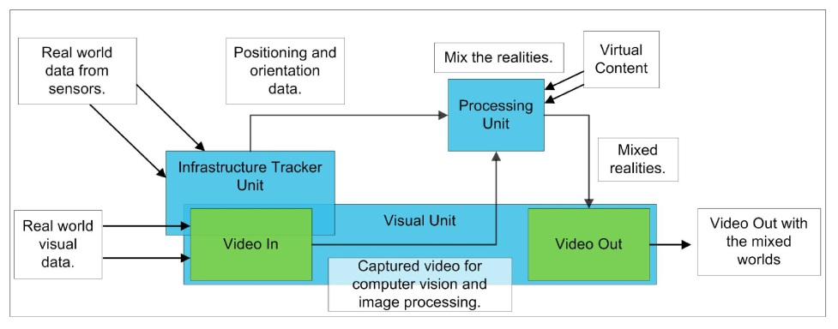
Applications of DIP

Slide 27
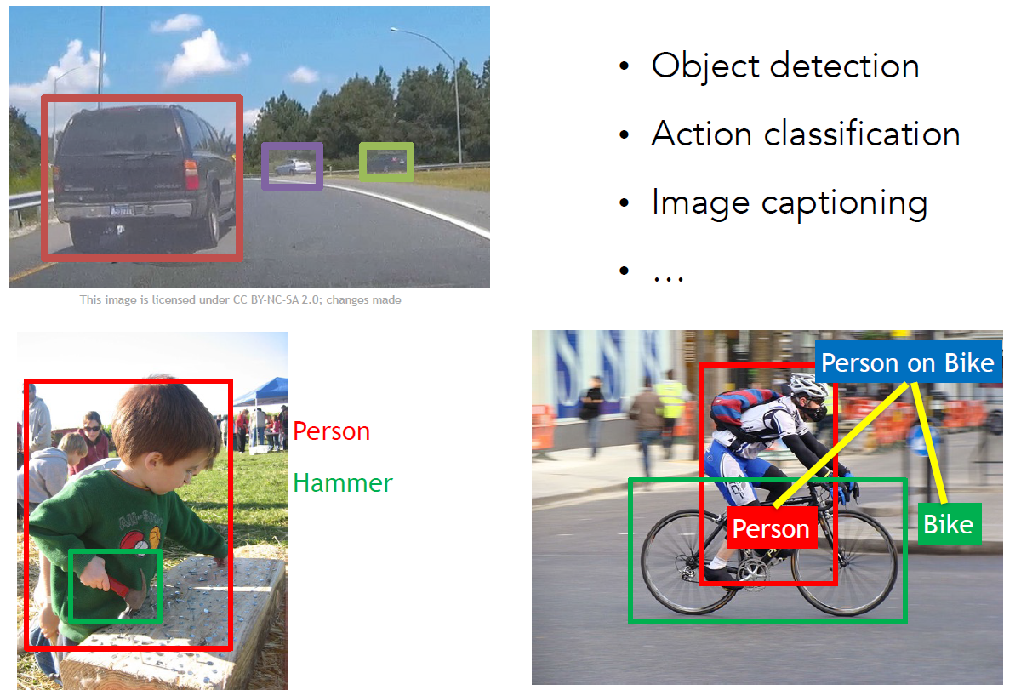
Applications of DIP

Slide 28
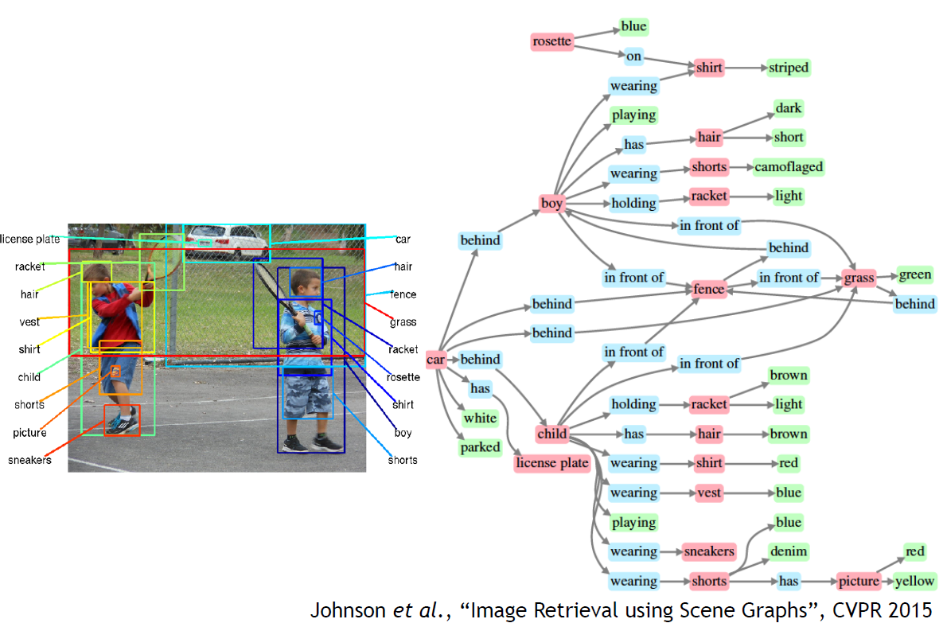
Applications of DIP
Deep Learning

Slide 29
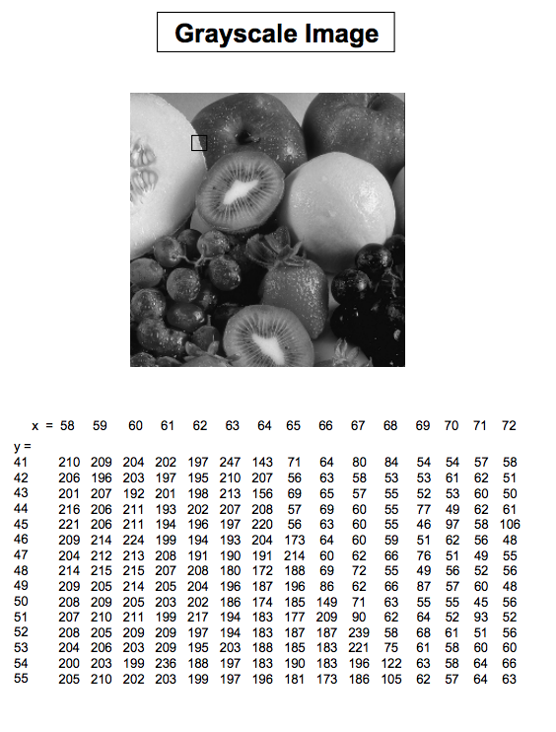
Basics of Digital Image Processing
Pixel
Basic relationships between pixels
Neighborhood
Adjacency
Connectivity
Regions and boundaries

Slide 30
Day 2
Image (color gray binary), dimension
Pixel, intensity
Pixel relationship, distance
Matlab, Matlab tutorial
https://www.tutorialspoint.com/matlab/matlab_environment.htm
Digital Image Processing using Matlab: Chapter 2 2.1-2.8
Start Basic Image Enhancement Tools (pdf)

Slide 31
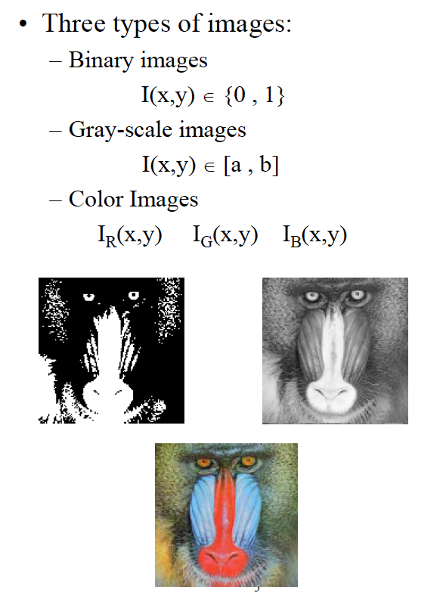
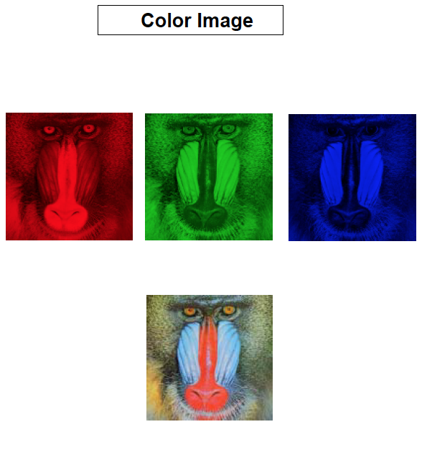
Basics of Digital Image Processing
Pixel
Image Intensity -Light energy emitted from a unit area in the image.
Image Gray-Level – The relative intensity at each unit area. Between the lowest intensity (Black value) and the highest intensity (White value).

Slide 32
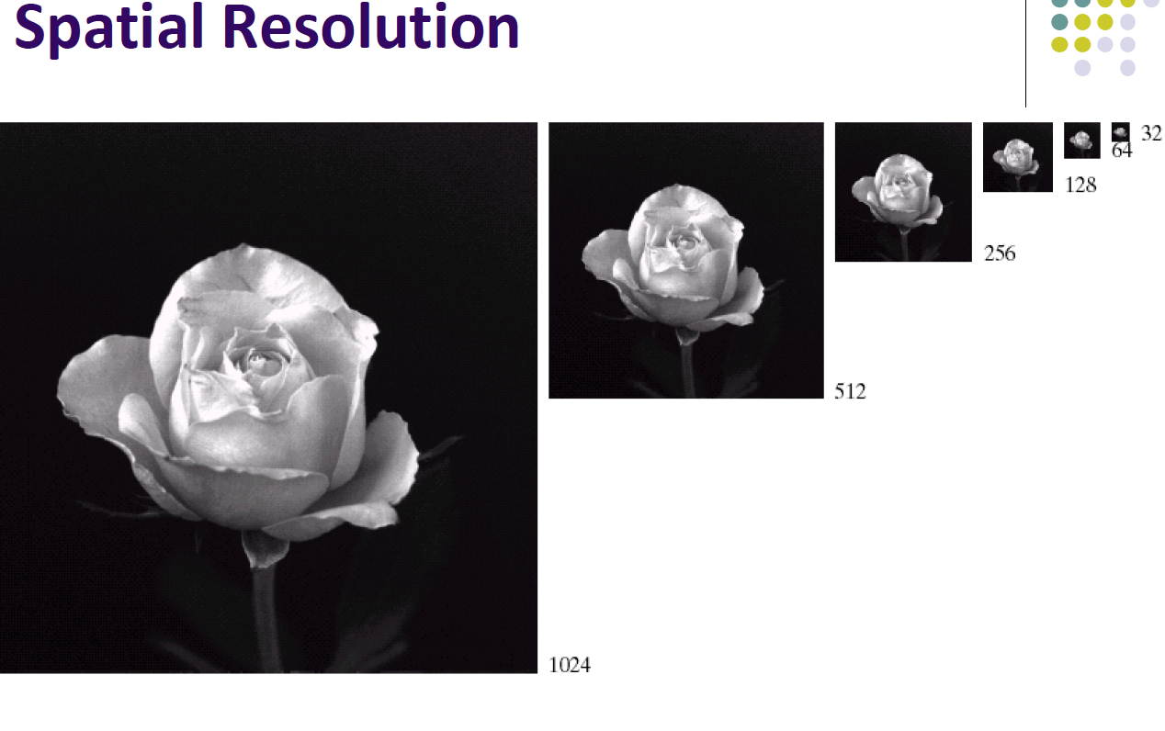
Basics of Digital Image Processing

Slide 33
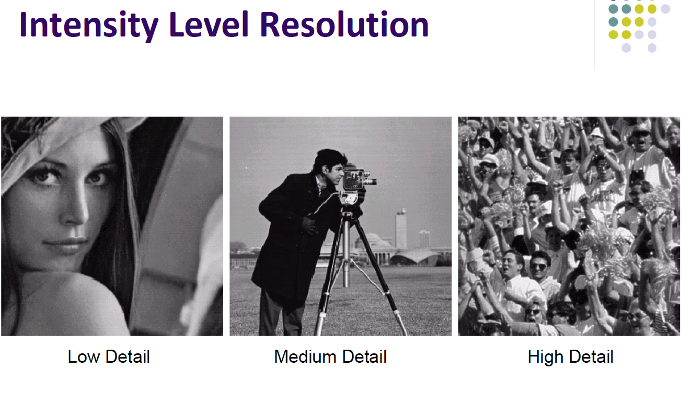
Basics of Digital Image Processing

Slide 34
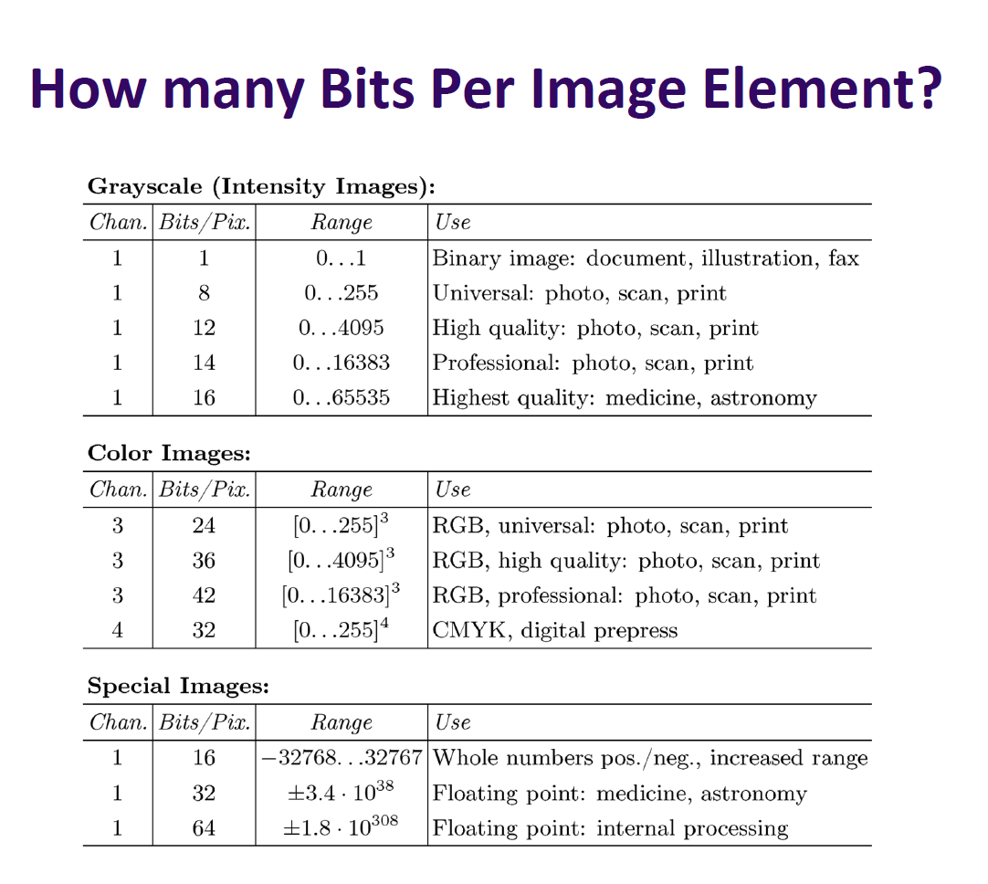
Basics of Digital Image Processing

Slide 35
Basic Relationships Between Pixels
Neighbors of a pixel p at coordinates (x,y)
4-neighbors of p, denoted by N₄(p):
(x-1, y), (x+1, y), (x,y-1), and (x, y+1).
4 diagonal neighbors of p, denoted by N_{D}(p):
(x-1, y-1), (x+1, y+1), (x+1,y-1), and (x-1, y+1).
8 neighbors of p, denoted N₈(p)
N₈(p) = N₄(p) U N_{D}(p)

Slide 36
Basic Relationships Between Pixels
Adjacency
Let S be the set of intensity values
4-adjacency: Two pixels p and q with values from S are 4-adjacent if q is in the set N₄(p).
8-adjacency: Two pixels p and q with values from S are 8-adjacent if q is in the set N₈(p).

Slide 37
Examples: Adjacency and Path
01,1 11,2 11,3 0 1 1 0 1 1
02,1 22,2 02,3 0 2 0 0 2 0
03,1 03,2 13,3 0 0 1 0 0 1
S = {1, 2}
(1,3) and (3,3)
Path : (1,3), (1,2), (2,2), (3,3)

Slide 38
Basic Relationships Between Pixels
Connected in S
Let S represent a subset of pixels in an image. Two pixels p with coordinates (x₀, y₀) and q with coordinates (x_{n}, y_{n}) are said to be connected in S if there exists a path
(x₀, y₀), (x₁, y₁), …, (x_{n}, y_{n})
Where

Slide 39
Basic Relationships Between Pixels
Let S represent a subset of pixels in an image
For every pixel p in S, the set of pixels in S that are connected to p is called a connected component of S.
If S has only one connected component, then S is called Connected Set.
We call R a region of the image if R is a connected set
Two regions, R_{i} and R_{j} are said to be adjacent if their union forms a connected set.
Regions that are not to be adjacent are said to be disjoint.

Slide 40
Basic Relationships Between Pixels
Boundary (or border)
The boundary of the region R is the set of pixels in the region that have one or more neighbors that are not in R.
If R happens to be an entire image, then its boundary is defined as the set of pixels in the first and last rows and columns of the image.
Foreground and background
An image contains K disjoint regions, R_{k}, k = 1, 2, …, K. Let R_{u} denote the union of all the K regions, and let (R_{u})^{c} denote its complement.
All the points in R_{u} is called foreground;
All the points in (R_{u})^{c} is called background.

Slide 41
Question 1
In the following arrangement of pixels, are the two regions (of 1s) adjacent? (if 8-adjacency is used)
1 1 1
1 0 1
0 1 0
0 0 1
1 1 1
1 1 1
Region 1
Region 2

Slide 42
Question 2
In the following arrangement of pixels, are the two parts (of 1s) adjacent? (if 4-adjacency is used)
1 1 1
1 0 1
0 1 0
0 0 1
1 1 1
1 1 1
Part 1
Part 2

Slide 43
In the following arrangement of pixels, the two regions (of 1s) are disjoint (if 4-adjacency is used)
1 1 1
1 0 1
0 1 0
0 0 1
1 1 1
1 1 1
Region 1
Region 2

Slide 44
In the following arrangement of pixels, the two regions (of 1s) are disjoint (if 4-adjacency is used)
1 1 1
1 0 1
0 1 0
0 0 1
1 1 1
1 1 1
foreground
background

Slide 45
Question 3
In the following arrangement of pixels, the circled point is part of the boundary of the 1-valued pixels if 8-adjacency is used, true or false?
0 0 0 0 0
0 1 1 0 0
0 1 1 0 0
0 1 1 1 0
0 1 1 1 0
0 0 0 0 0

Slide 46
Question 4
In the following arrangement of pixels, the circled point is part of the boundary of the 1-valued pixels if 4-adjacency is used, true or false?
0 0 0 0 0
0 1 1 0 0
0 1 1 0 0
0 1 1 1 0
0 1 1 1 0
0 0 0 0 0

Slide 47
Distance Measures
Given pixels p, q and z with coordinates (x, y), (s, t), (u, v) respectively, the distance function D has following properties:
D(p, q) ≥ 0 [D(p, q) = 0, iff p = q]
D(p, q) = D(q, p)
D(p, z) ≤ D(p, q) + D(q, z)

Slide 48
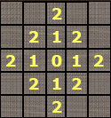
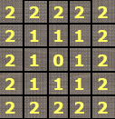
Distance Measures
The following are the different Distance measures:
a. Euclidean Distance :
D_{e}(p, q) = [(x-s)² + (y-t)²]^{1/2}
b. City Block Distance:
D₄(p, q) = |x-s| + |y-t|
c. Chess Board Distance:
D₈(p, q) = max(|x-s|, |y-t|)

Slide 49
Question 5
In the following arrangement of pixels, what’s the value of the chessboard distance between the circled two points?
0 0 0 0 0
0 0 1 1 0
0 1 1 0 0
0 1 0 0 0
0 0 0 0 0
0 0 0 0 0

Slide 50
Question 6
In the following arrangement of pixels, what’s the value of the city-block distance between the circled two points?
0 0 0 0 0
0 0 1 1 0
0 1 1 0 0
0 1 0 0 0
0 0 0 0 0
0 0 0 0 0

Slide 51
Day 2
Image (color gray binary), dimension
Pixel, intensity
Pixel relationship, distance
Matlab, Matlab tutorial
https://www.tutorialspoint.com/matlab/matlab_environment.htm
Digital Image Processing using Matlab: Chapter 2 2.1-2.8
Start Basic Image Enhancement Tools (pdf)

Slide 52
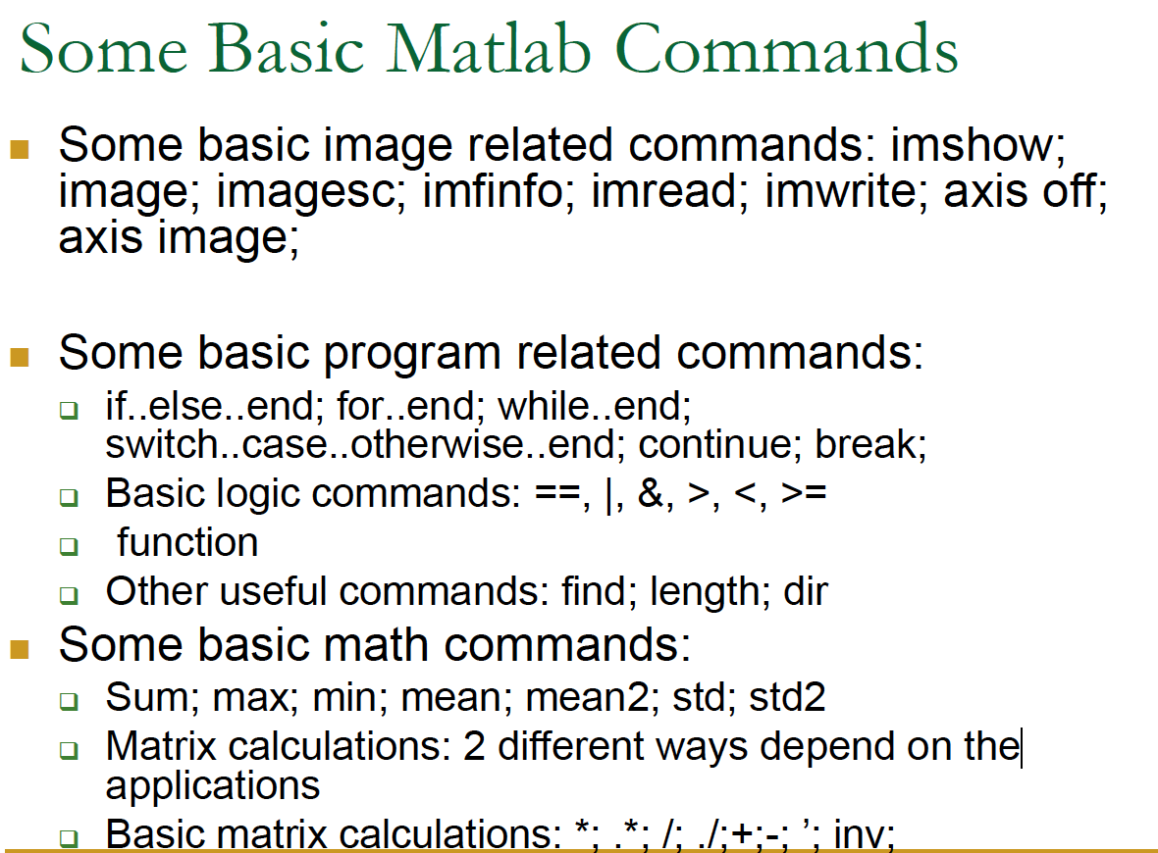
Matlab basics

Slide 53
Matlab matrix/image operation
Array vs. Matrix Operation
Array product
operator
Array product
Matrix product
operator
Matrix product

Slide 54
Exercise
A=[1 2 3; 1 2 3];
A(2,2)
A(:)
A(:,1)
Imshow(im); % if integer expecting [0 255]
Imshow(im); % if double, expecting [0 1]
Figure, index -> intensity , settings
Image(im); % color image works fine.
Image(im); colormap(gray(256)) ; % for grayscale image

Slide 55
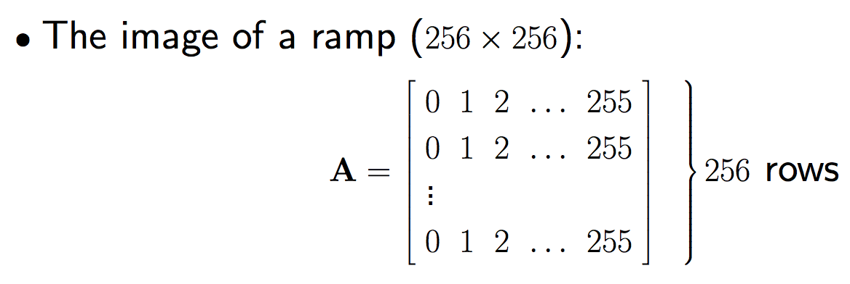
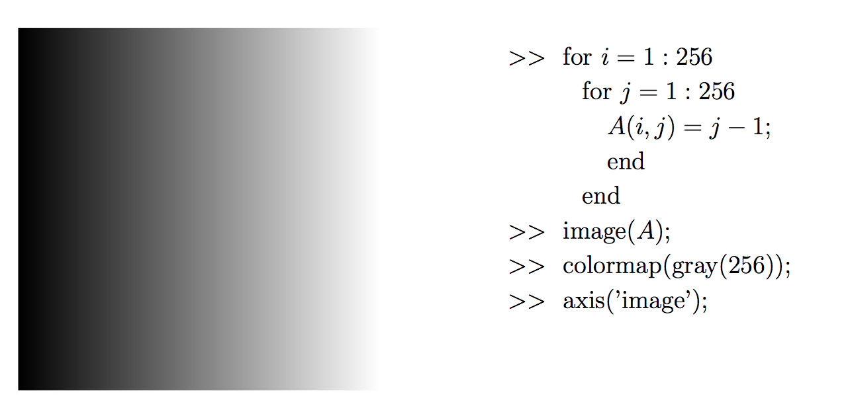
Exercise

Slide 56


Exercise
How about this?

Slide 57
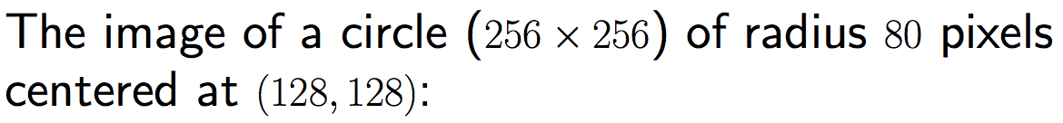
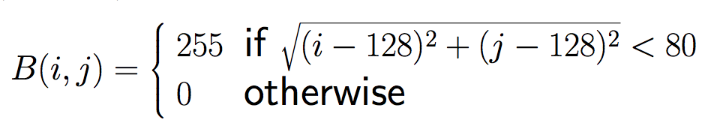

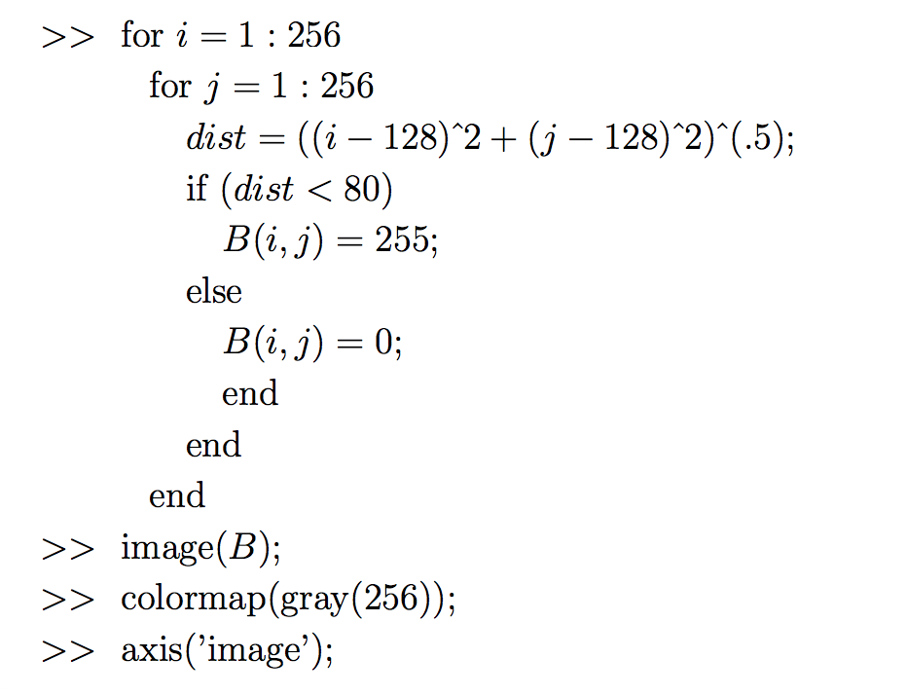
Exercise

Slide 58
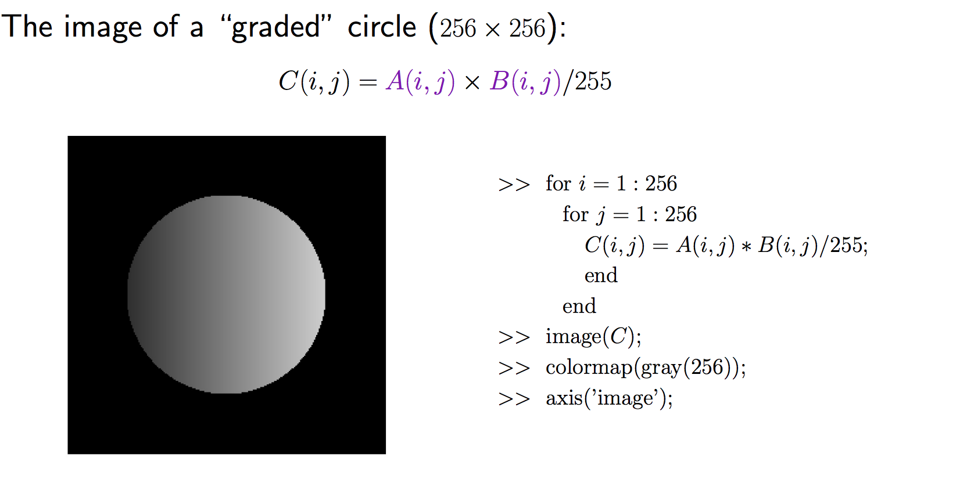
Exercise

Slide 59
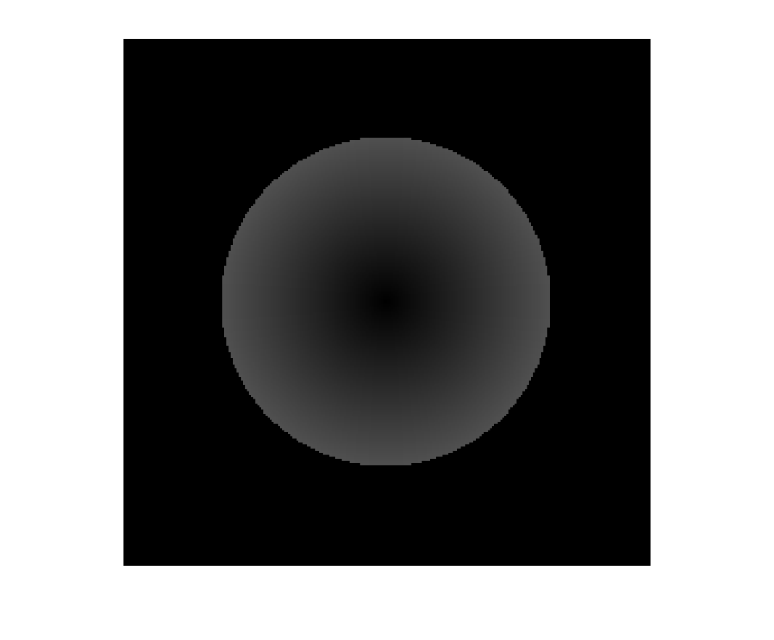

Exercise
How about this?

Slide 60
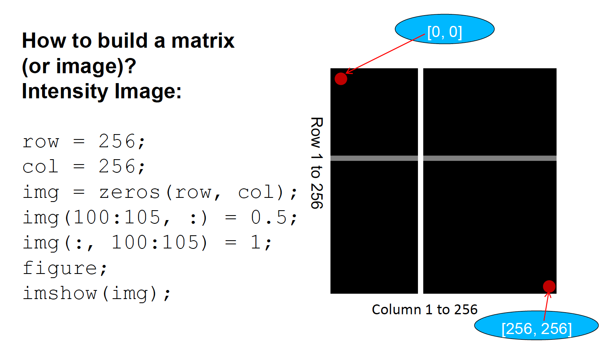
Exercise
How about this?
Answer…

Slide 61
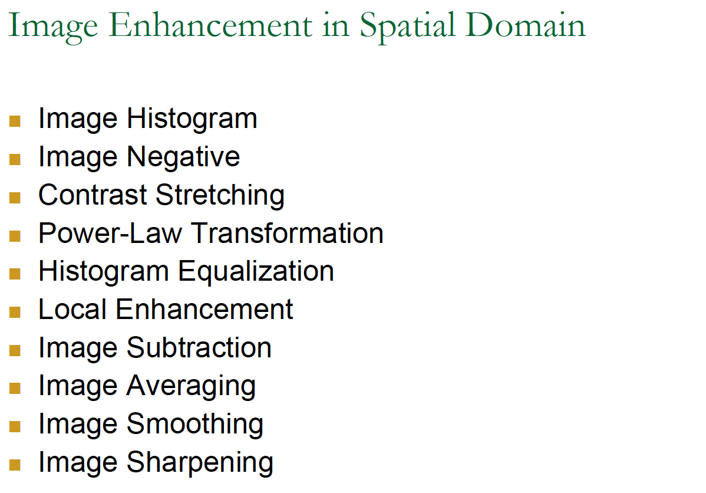

Slide 63
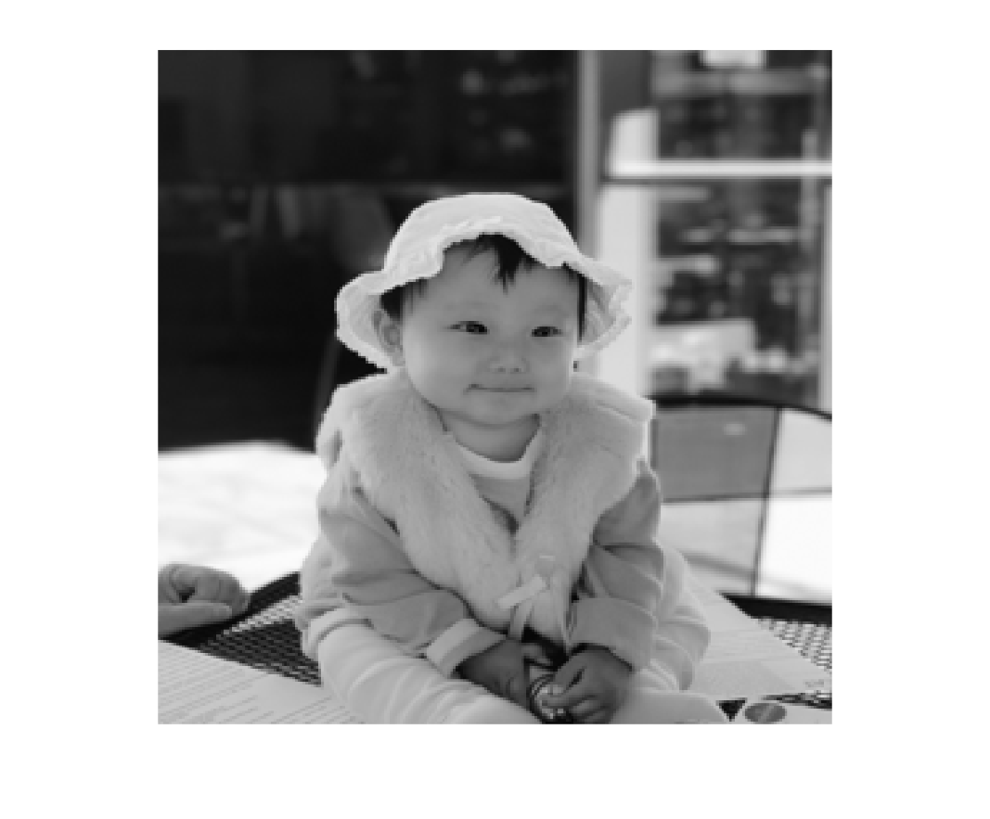

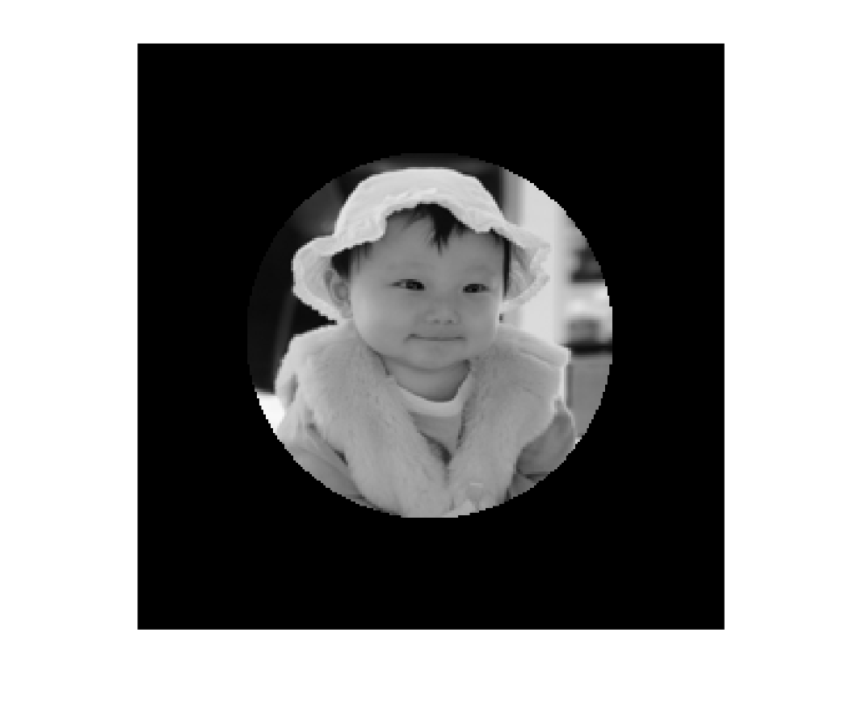
Assignment 0
Assignment 0 (get to know matlab and show one image)
Download and install matlab
Practice the exercises
Change the “graded circle” image by inserting your own picture into the center part.

